Slide 1
House recommendation
By: Ashwill Daniels
Date: 11 Sep 2022
Data: Brazil Real Estate Listings (BigQuery public dataset)

Slide 2
Objective
Find the cheapest house in each state of Brazil that meets certain criteria.
Criteria:
Building type: house
Bedrooms: 3
Must have cost per square meter data

Slide 3
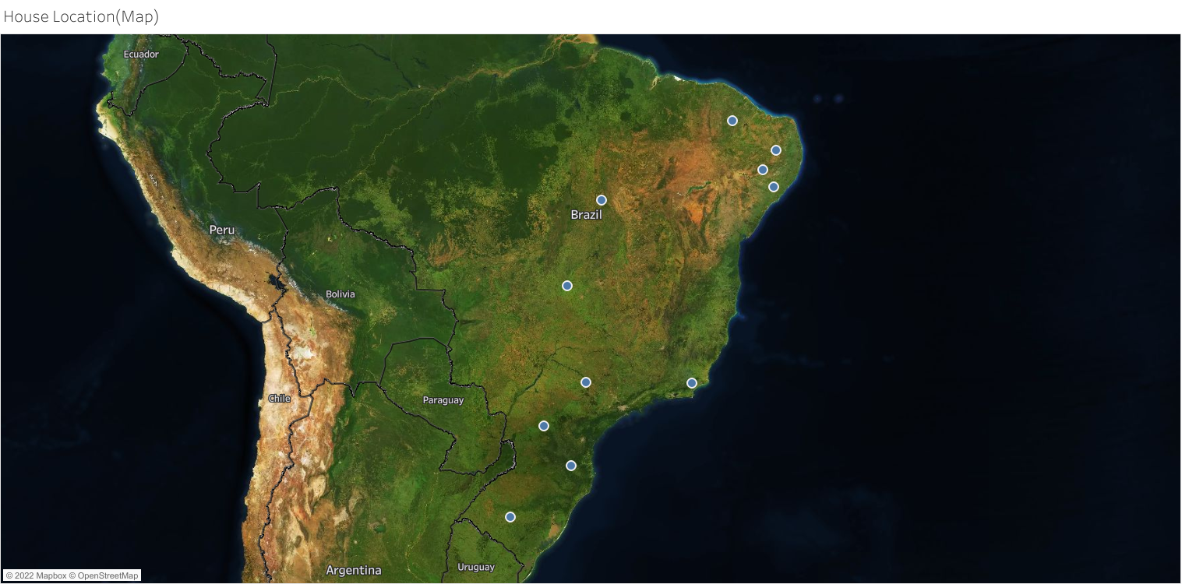
Map data of houses(Tableau)

Slide 4
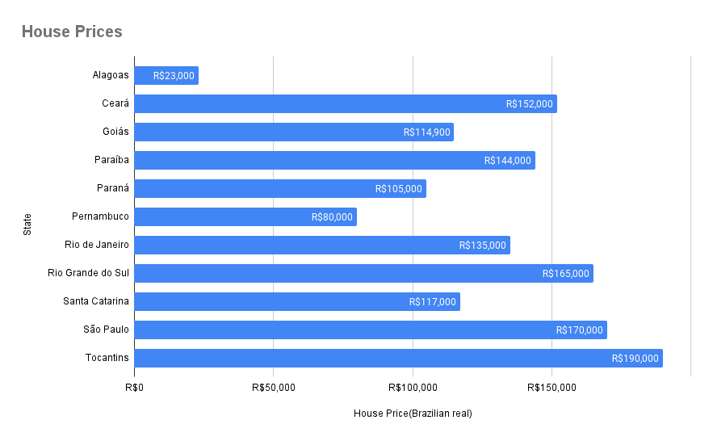
House prices(1 per state)

Slide 5
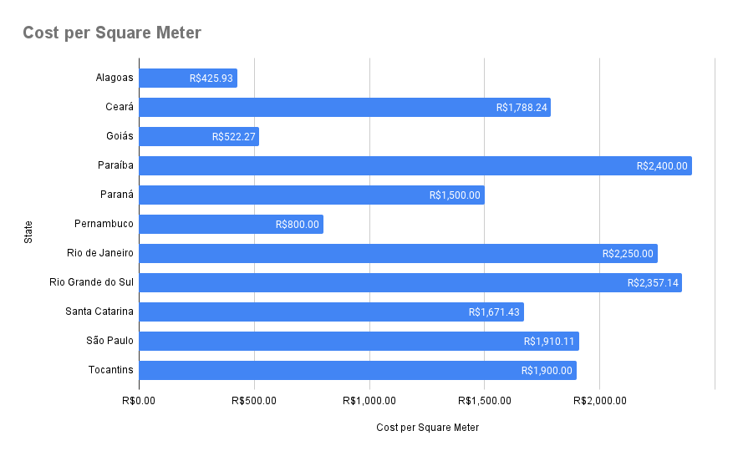
Cost per square meter

Slide 6

Recommendation

Slide 7
Appendix
BigQuery dataset ID:
properati-data-public.properties_br
Tableau presentation: https://public.tableau.com/app/profile/ashwill.daniels/viz/CheaphousesBrazil/Map

